Slide 1
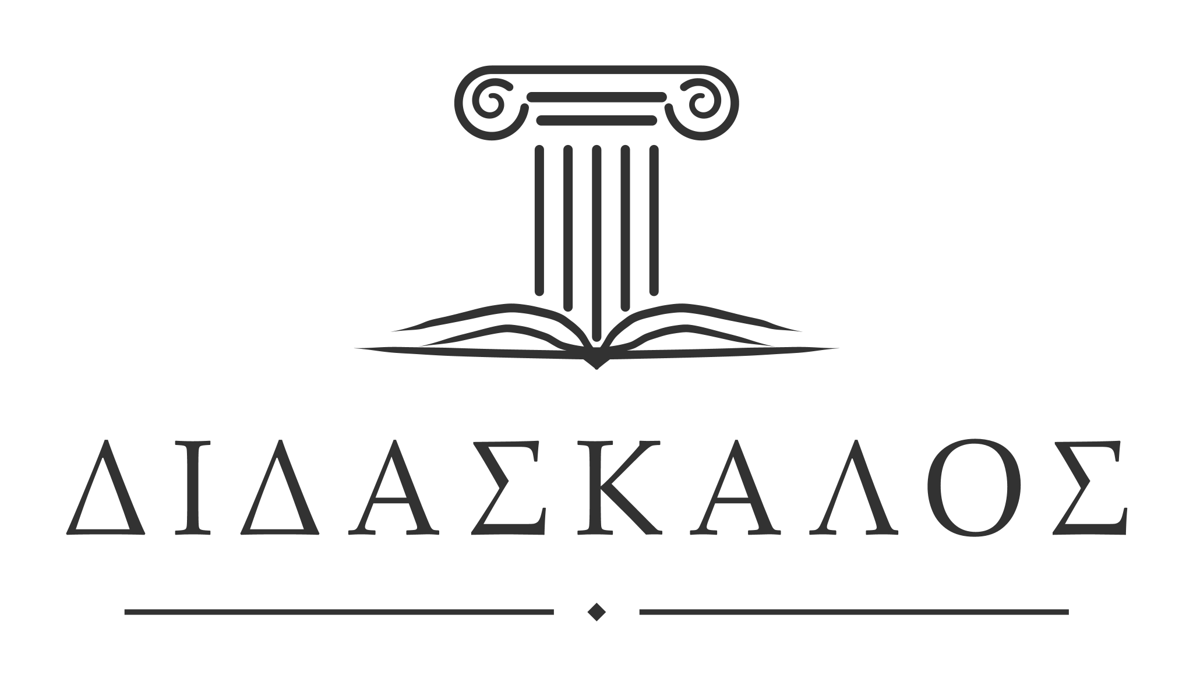
Didaskalos:
Towards Building Multilingual Corpus-driven Textbooks for Ancient Greek Language
Farnoosh Shamsian · Digital Pedagogy Institute 2026

Slide 2
Agenda
Part 1 — The access problem
Part 2 — Didaskalos, a corpus-driven textbook pipeline
Part 3 — Localization in Persian

Slide 3
Part 1
The access problem
Who gets to read the source texts directly?

Slide 4
Why Herodotus wrote
«…μήτε ἔργα μεγάλα τε καὶ θωμαστά, τὰ μὲν Ἕλλησι τὰ δὲ βαρβάροισι ἀποδεχθέντα, ἀκλεᾶ γένηται»
“…so that great and wondrous deeds — some performed by Greeks, some by non-Greeks (barbarians) — may not lose their glory.”
HERODOTUS, HISTORIES 1.1

Slide 5
Persian history, written in Greek
For readers in Iran and across West and Central Asia, as well as in parts of Africa, Ancient Greek texts are primary sources of their own past
Much of the surviving narrative of ancient Persia comes to us in Ancient Greek
Yet in Persian, they are mostly available through indirect translations
European interpretive choices are inherited along through mediating texts

Slide 6
Statement of the problem
From before the Greco-Persian wars until long after Alexander’s conquest, Persia and the Greek world were deeply entangled. Yet in Persian today:
No established academic program
Ancient Greek is not taught regularly in any institution in Iran.
Few direct translations
Persian translations arrive via English, French or German.
Indirect translations
Multiple indirect translation of one text is common.
Accuracy drift
Every mediating edition adds its own interpretive layer.
No documentary versions
Nothing built for philological or historical citation.
Scarce teaching material
No functional grammar, reader or textbook aimed at Persian speakers.

Slide 7
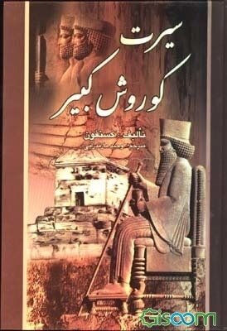
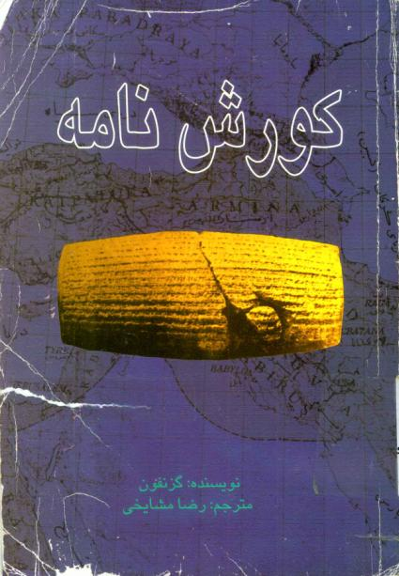
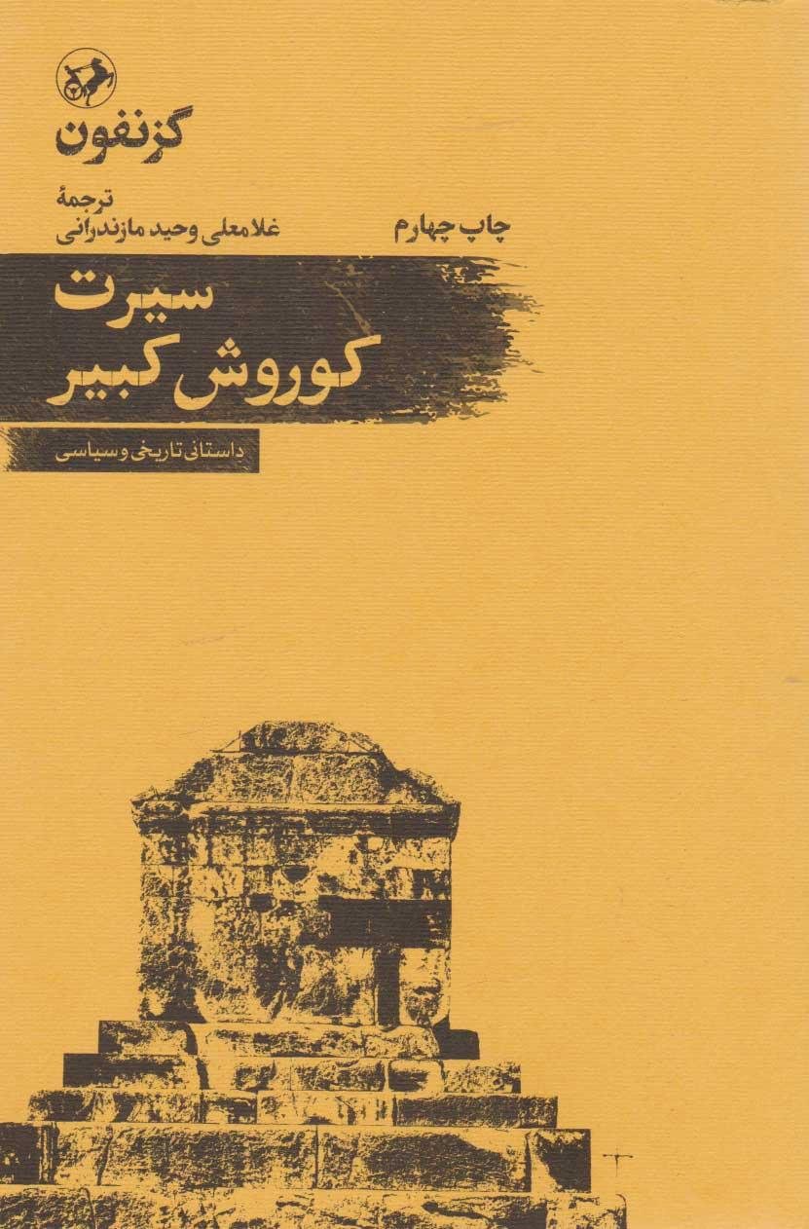
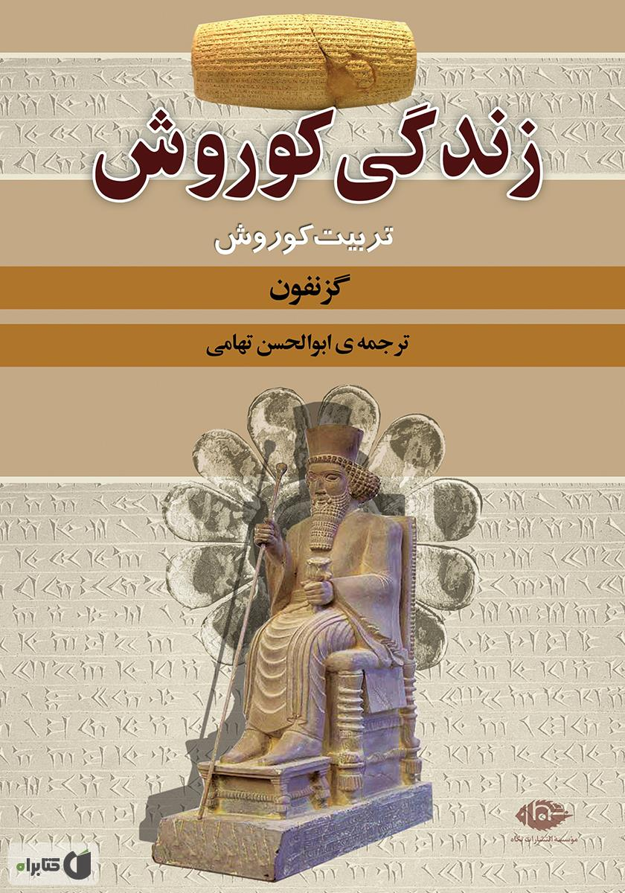
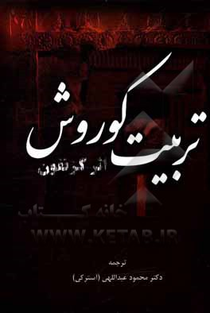

Multiple indirect translations of the same text
Cyropaedia — Xenophon’s partly fictional life of Cyrus II
At least eight indirect translations into Persian — not one from the Greek.
Six of the Persian Cyropaedia translations in print. Each was made from an English or French edition.

Slide 8
Project Context & Aims
Few languages have abundant resources on Ancient Greek texts
What does that mean for localization into low-resource languages?
No need to start from ground zero
Removing translation barriers — above all grammar explained through the learner’s first language
Developing localizable pedagogical resources
Digital annotations and tools as teaching materials

Slide 9
Part 2
Didaskalos
The modular, localizable textbook

Slide 10
Didaskalos: a textbook generated from the texts you choose
Didaskalos (διδάσκαλος, ‘teacher’) is an open-source pipeline that builds a personalized Ancient Greek textbook from whatever treebank corpus a user selects.
85 works by 25 authors and collections built in — or upload your own treebanks.
Every Greek sentence is an authentic sentence from that corpus.
Grammar topics are ordered by what the corpus actually uses, not by a fixed curriculum.
Free and browser-based, nothing to install. Markdown or HTML output.
Each generated textbook carries a colophon naming every source corpus, its licence and URL (the project itself is CC BY-NC-SA 4.0).

Slide 11
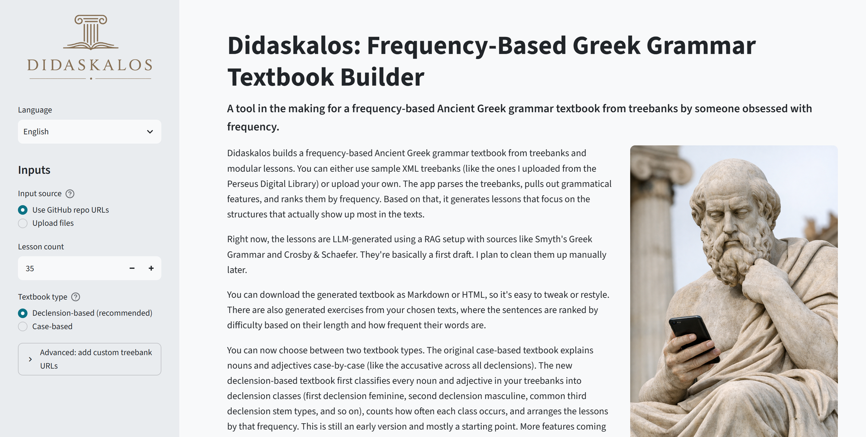
The Python app on Google Cloud Run
The English interface. Pick a corpus, a lesson count and a textbook type; the build runs server-side and returns a downloadable book.

Slide 12
Three choices, one book
Choose your text
from the 85 built-in works, or upload your own treebanks
Download your textbook
as Markdown or HTML
(+ the datasets as CSV)
Choose the textbook type
based on how noun declensions are explained
Choose number of lessons
default is 40; 157 lesson modules are available

Slide 13
The build pipeline, step by step
1 · Corpus
2 · Analyze
3 · Syllabus
4 · Assemble
Builds the corpus from the chosen texts and decodes the morphology of every token.
Counts the frequency of every form and every lemma, and ranks sentences by difficulty.
Orders topics by frequency, inside a fixed opening and some bound lesson sequences.
Pairs each topic with a lesson module and difficulty-scored corpus exercises with an answer key.
Every example is an authentic corpus sentence, ranked by difficulty (based on sentence length plus word rarity), so early lessons stay readable, then exported as CSV, Markdown or HTML.
Thucydides, The Peloponnesian War → 31,924 tokens · 119 ranked grammar topics.

Slide 14
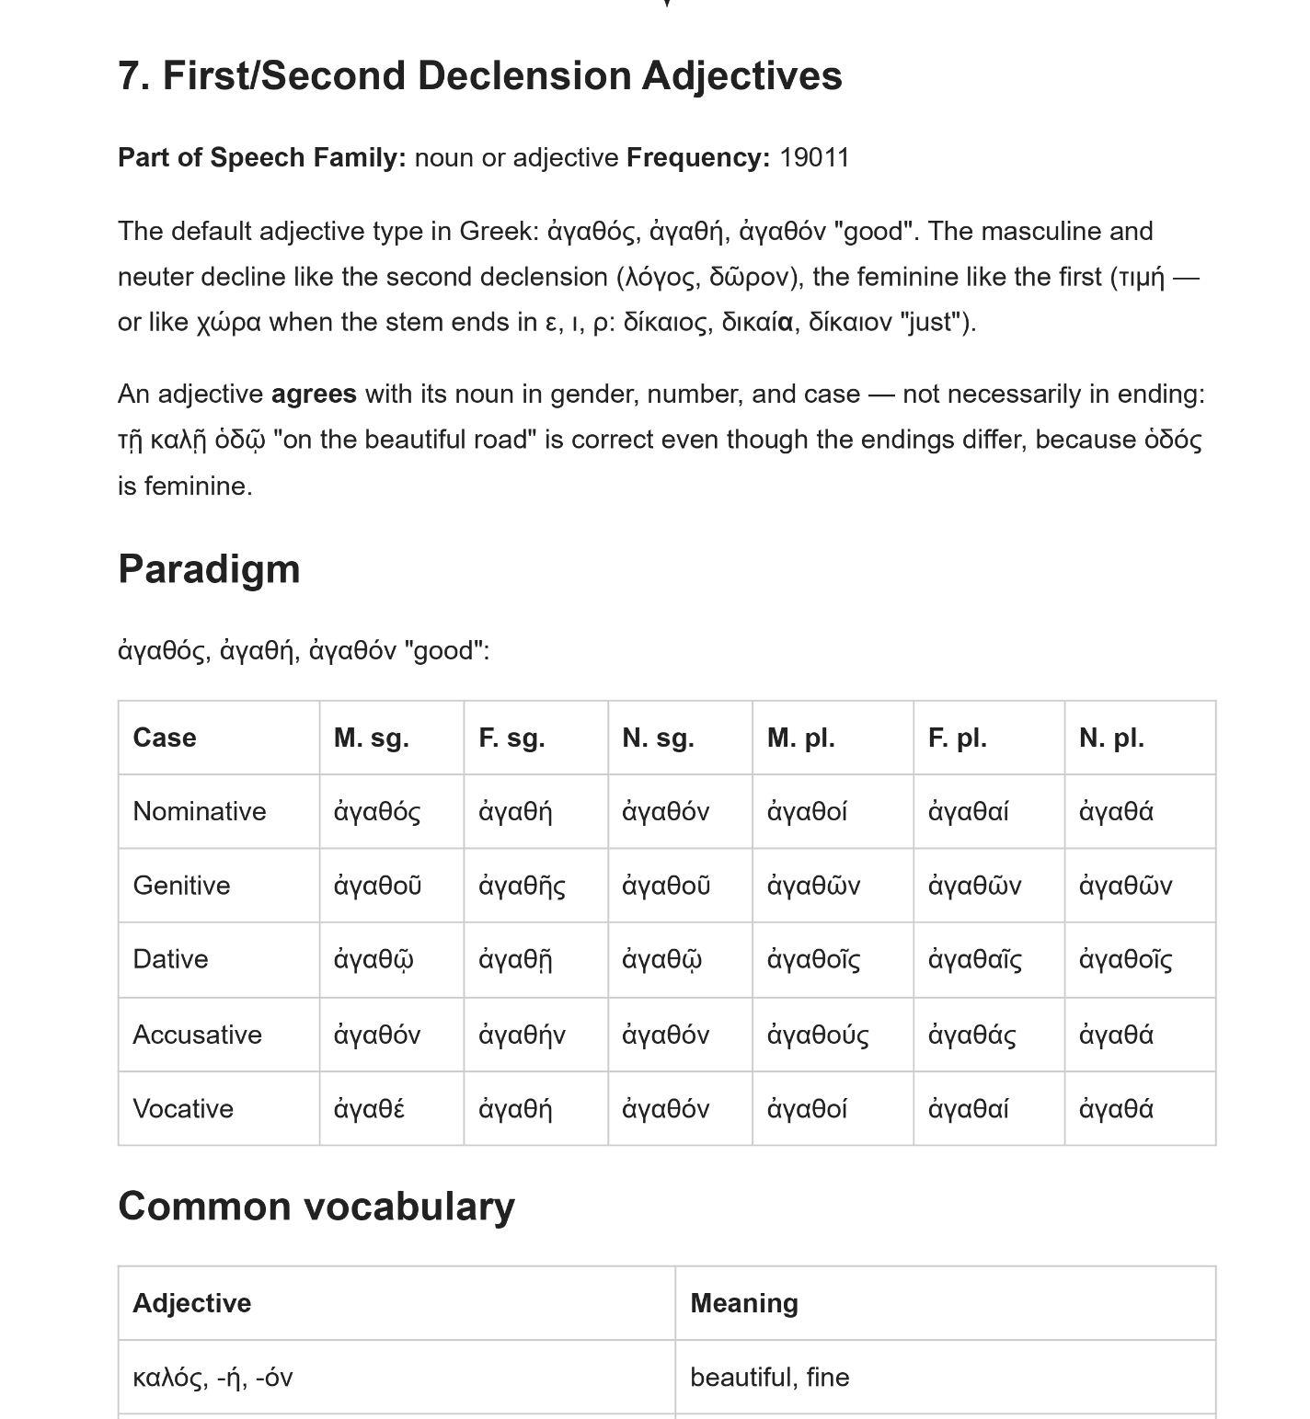
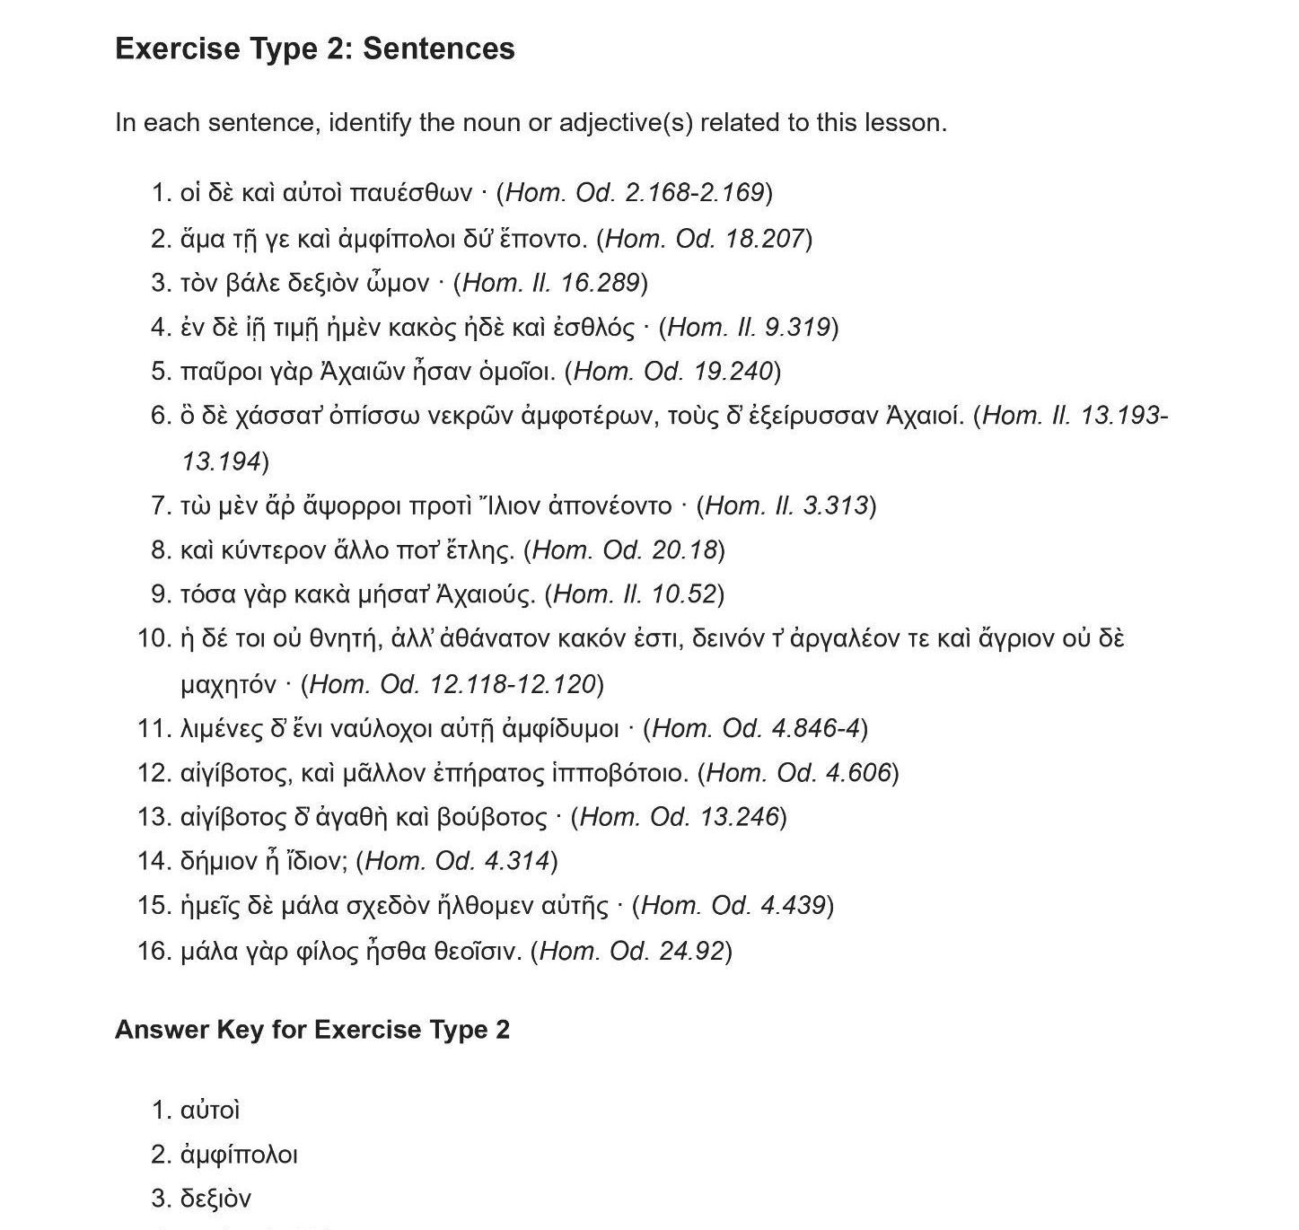
Examples from a textbooks based on Homer
The lesson: a paradigm assembled for the topic the corpus ranked seventh.
Its exercises: unaltered Homer, every sentence carrying its citation.

Slide 15
When frequency and pedagogy disagree
Problems:
The most common form in a corpus can be an irregular or an advanced one.
Teach an exception first and you confuse beginners before the rule even exists.
Some topics only make sense together: the middle voice raises questions that deponent verbs must answer right after.
Solutions:
A fixed opening: the first lessons map the system before frequency takes over, so beginners are oriented rather than overwhelmed.
Bound sequences: linked lessons stay adjacent — middle voice is always followed by deponent verbs.
After the opening, corpus frequency orders everything else.

Slide 16
Part 3
Localization in Persian
From the interface to the generated textbook — فارسی throughout

Slide 17
What localization actually touched
The interface, the lesson modules, the grammatical terminology and the exported textbook are all localized in Persian.
A curated English–Persian table keeps grammatical terms consistent.
One rule makes it translatable: no comparisons with the learner’s 1st language.
Adding another language is one locale file plus translated modules.
Handling of mixed RTL and LTR content is already implemented.

Slide 18
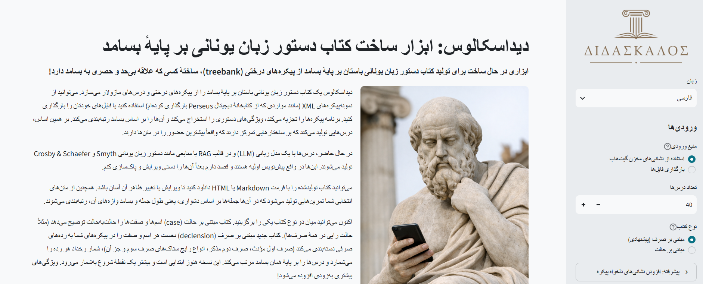
The app in Persian
The same build, mirrored: sidebar on the right, Persian throughout, and Latin-script technical terms still reading left-to-right inside it.

Slide 19
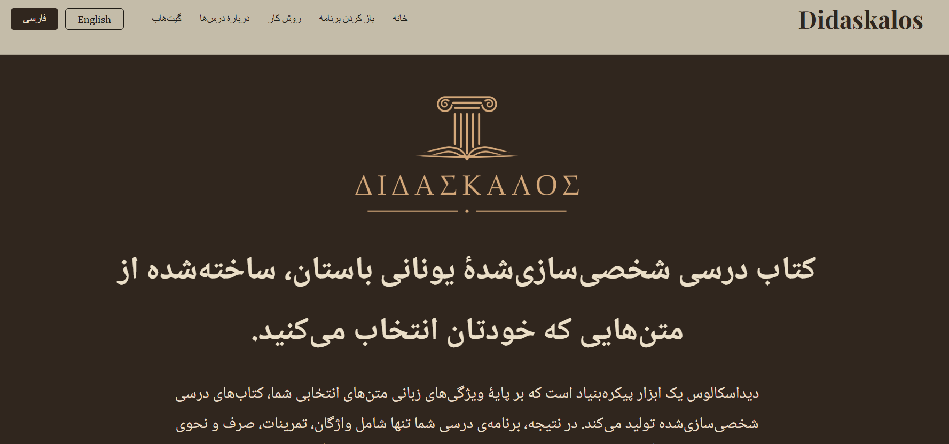
The project site in Persian
Documentation and interface are localized together — a reader never has to pass through English to reach the tool.

Slide 20
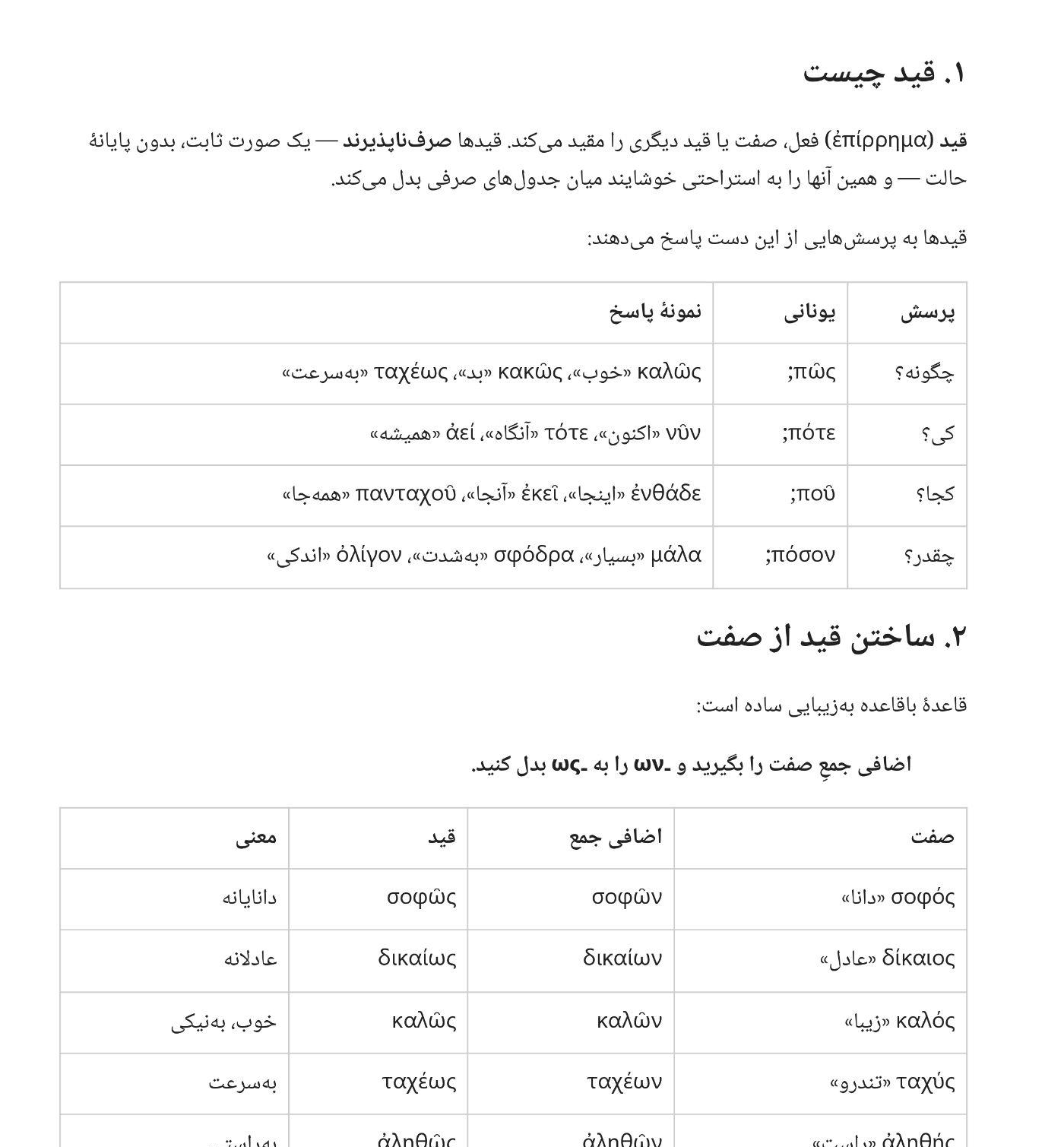
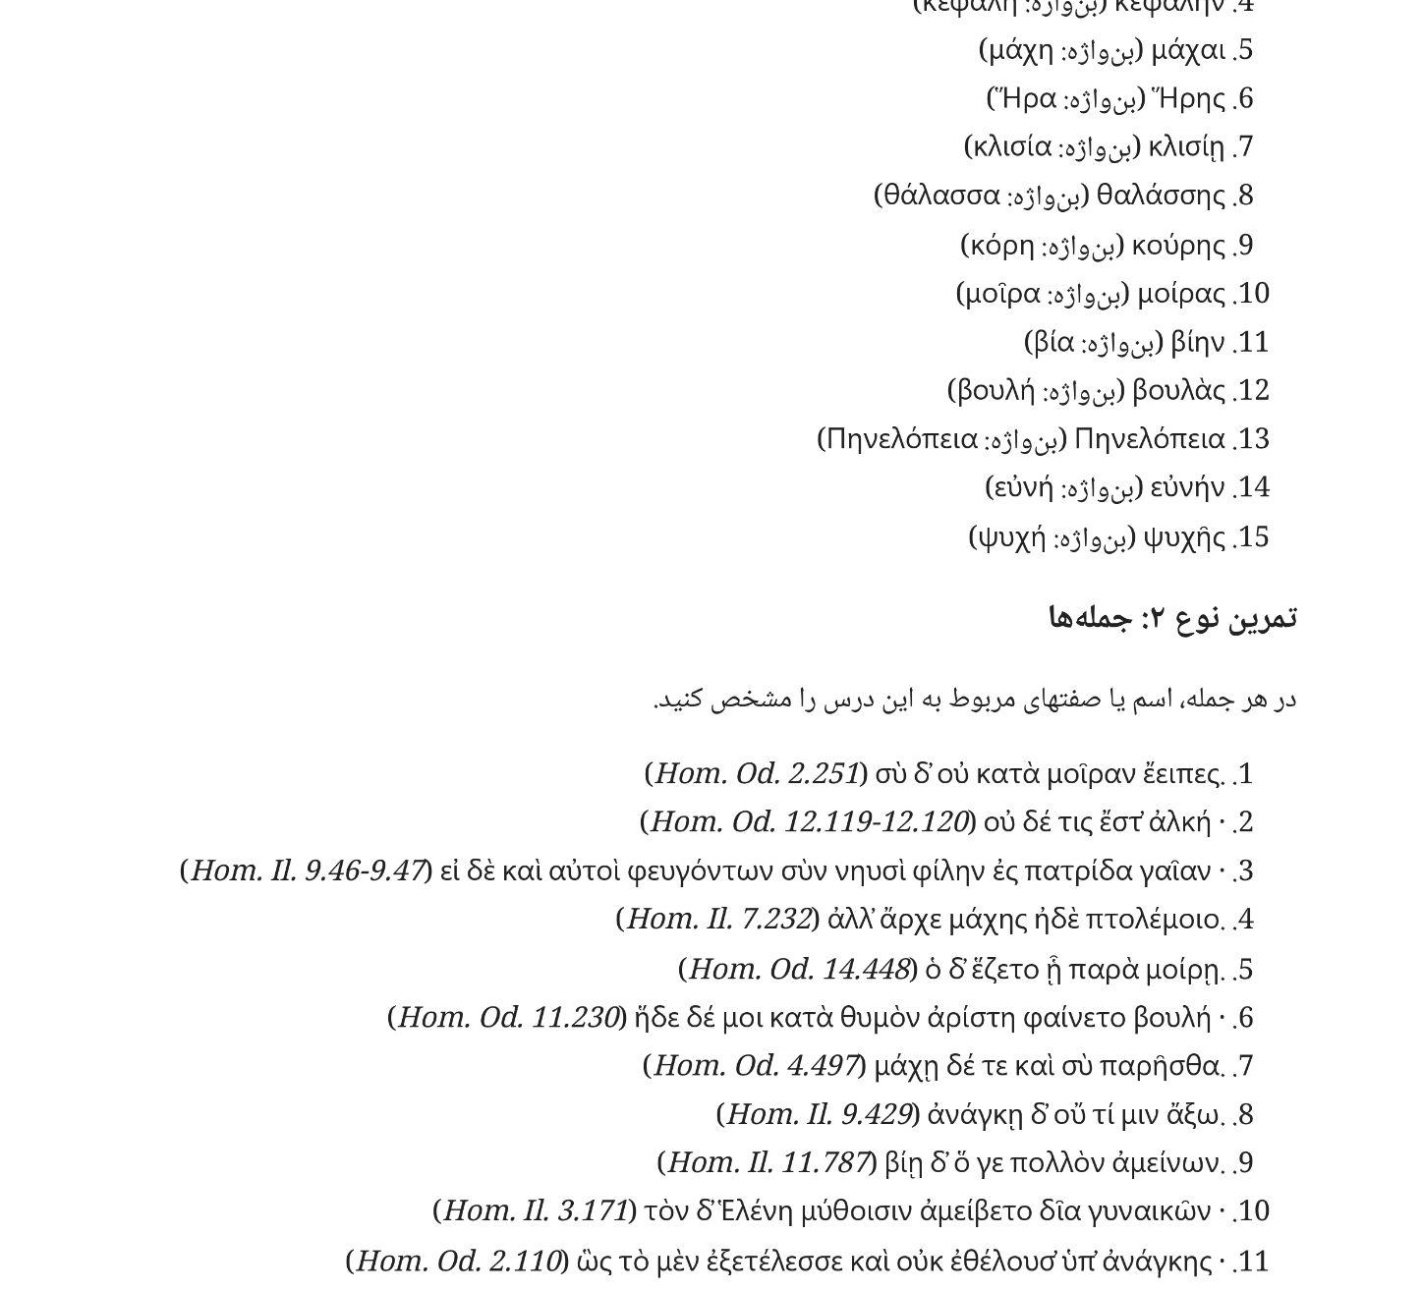
Generated exercises in Persian — nothing simplified
The lesson: Greek question words glossed in Persian, no English anywhere.
Its exercises: the instruction in Persian, the sentences unaltered Homer.

Slide 21
Open problems I’m still working through
The RAG-drafted grammar modules still need review — first drafts came from a retrieval pipeline over reference grammars (Smyth, Crosby & Schaeffer).
Source treebanks sometimes disagree or carry undecodable or misaligned tags.
Whether the auto-selected exercises are genuinely useful still needs systematic evaluation.
Syntax is barely used — the syllabus is driven by morphology alone (adding Didakta would help).
Rare paradigms in the long tail still have no lesson file, so large builds can hit a “module not found”.
Greek set inside right-to-left Persian still needs some attention.

Slide 22
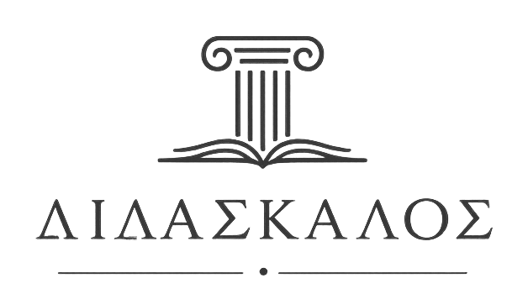
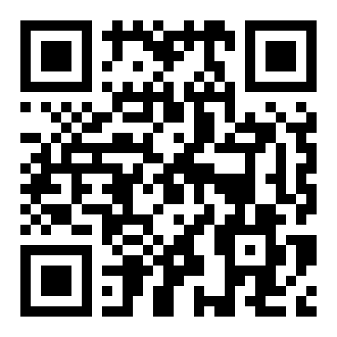
Thank you!
Project site: farnoosh-shamsian.github.io/didaskalos
Try the app: https://tinyurl.com/didaskalos
Code and corpora: github.com/farnoosh-shamsian/didaskalos
Scan to open the app
Farnoosh Shamsian · Didaskalos · Digital Pedagogy Institute 2026

